Slide 1
INFO-3142
Python Overview

Slide 2
Synopsis
Python has multiple built-in data types, such as:
integers, floats, complex numbers, strings, lists, tuples, dictionaries, and file objects
These data types can be manipulated using language operators, built-in functions, library functions, or a data type’s own methods
Programmers can also define their own classes and instantiate their own class instances
These class instances can be manipulated by programmer-defined methods, as well as the language operators and built-in functions for which the programmer has defined the appropriate special method attributes

Slide 3
Synopsis
Python provides conditional and iterative control flow through an if-elif-else construct along with while and for loops
Allows function definition with flexible argument-passing options
Exceptions (errors) can be raised by using the raise statement, and they can be caught and handled by using the try-except-elsefinally construct
Variables (or identifiers) don’t have to be declared and can refer to any built-in data type, user-defined object, function, or module

Slide 4
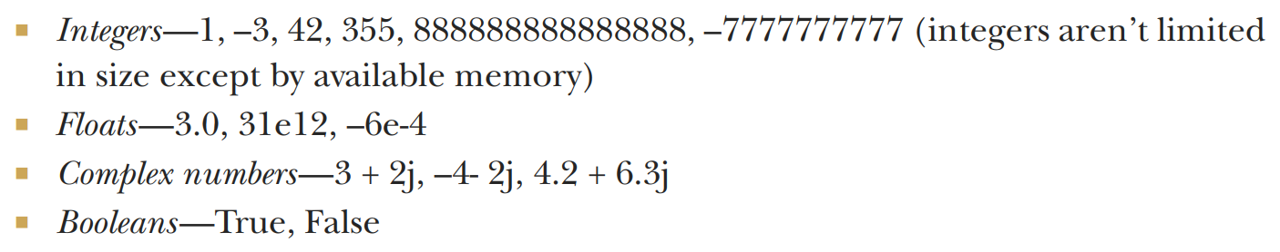
Built-in Types
Numbers
Python’s four number types are integers, floats, complex numbers, and Booleans:

Slide 5
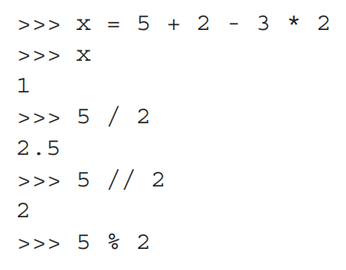
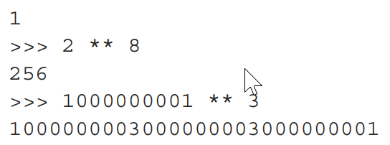
Built-in Types
Manipulate them by using the arithmetic operators: + (addition), – (subtraction), * (multiplication), / (division), ** (exponentiation), and % (modulus)

Slide 6
Built-in Types
These examples work with floats, which are based on the doubles in C, Java or C#:
x = 5 + 2 - 3 * 2
print(x)
print(5 / 2)
print(5 // 2)
print(5 % 2)
print(2 ** 8)
print(1000000001 ** 3)

Slide 7
Built-in Types
There is the library module math (which contains functions for the other three non-complex number types):
x = 4.3 ** 2.4
print(x)
print(3.5e30 * 2.77e45)
print(1000000001.0 ** 3)

Slide 8
Built-in Types
Booleans:
x = False
print(x)
print(not x)
y = True * 2
print(y)

Slide 9
Built-in Types
Lists:
x = ["first", "second", "third", "fourth"]
print(x[0])
print(x[2])
print(x[-1])
print(x[-2])
print(x[1:-1])
print(x[0:3])
print(x[-2:-1])
print(x[:3])
print(x[-2:])

Slide 10
Built-in Types
Tuples:
Tuples are similar to lists but are immutable—that is, they can’t be modified after they’ve been created
x = [1, 2, 3, 4]
print(tuple(x))
#(1, 2, 3, 4)
x = (1, 2, 3, 4)
print(list(x))
#[1, 2, 3, 4]

Slide 11
Built-in Types
Strings:
x = "live and let \t \tlive"
print(x.split())
#['live', 'and', 'let', 'live']
print(x.replace(" let \t \tlive", "enjoy life"))
#'live and enjoy life'
import re
regexpr = re.compile(r"[\t ]+")
print(regexpr.sub(" ", x))
#'live and let live'

Slide 12
Built-in Types
Dictionaries:
Python’s built-in dictionary data type provides associative array functionality implemented by using hash tables
Key, value pairs

Slide 13
Built-in Types
x = {1: "one", 2: "two"}
x["first"] = "one"
x[("Delorme", "Ryan", 1995)] = (1, 2, 3)
print(list(x.keys()))
#['first', 2, 1, ('Delorme', 'Ryan', 1995)]
print(x[1])
#'one'
print(x.get(1, "not available"))
#'one'
print(x.get(4, "not available"))
#'not available'

Slide 14
Built-in Types
Sets:
A set in Python is an unordered collection of objects, used in situations where membership and uniqueness in the set are the main things you need to know about that object
Sets behave as collections of dictionary keys without any associated values
x = set([1, 2, 3, 1, 3, 5])
print(x)
#{1, 2, 3, 5}
print(1 in x)
#True
print(4 in x)
#False

Slide 15
Built-in Types
File Objects:
f = open("myfile", "w")
result = f.write("First line with necessary newline character\n")
print(result)
#44
result = f.write("Second line to write to the file\n")
print(result)
#33
f.close()

Slide 16
Built-in Types
File Objects:
f = open("myfile", "r")
line1 = f.readline()
line2 = f.readline()
f.close()
print(line1, line2)
#First line with necessary newline character
#Second line to write to the file

Slide 17
Built-in Types
File Objects:
import os
print(os.getcwd())
#c:\My Documents\test
# note the bug in the book code for this environment
# need to have the double slash following c: as in c:\\
print(os.path.join("c:\\", "My Documents", "Images"))
os.chdir(os.path.join("c:\\", "My Documents", "Images"))
filename = os.path.join("c:\\", "My Documents", "test", "myfile")
print(filename)
#c:\My Documents\test\myfile

Slide 18
Built-in Types
File Objects:
f = open(filename, "r")
print(f.readline())
#First line with necessary newline character
f.close()

Slide 19
Control Flow Structures
if-elif-else:
x = 5
if x < 5:
y = -1
z = 5
elif x > 5:
y = 1
z = 11
else:
y = 0
z = 10
print(x, y, z)

Slide 20
Control Flow Structures
while:
u, v, x, y = 0, 0, 100, 30
while x > y:
u = u + y
x = x - y
if x < y + 2:
v = v + x
x = 0
else:
v = v + y + 2
x = x - y - 2
print(u, v)

Slide 21
Control Flow Structures
for:
item_list = [3, "string1", 23, 14.0, "string2", 49, 64, 70]
for x in item_list:
if not isinstance(x, int):
continue
if not x % 7:
print("found an integer divisible by seven: %d" % x)
break

Slide 22
Control Flow Structures
functions:
def funct1(x, y, z):
value = x + 2*y + z**2
if value > 0:
return x + 2*y + z**2
else:
return 0
u, v = 3, 4
print(funct1(u, v, 2))
#15
print(funct1(u, z=v, y=2))
#23

Slide 23
Control Flow Structures
functions:
print(funct1(u, v, 2))
#15
print(funct1(u, z=v, y=2))
#23
def funct2(x, y=1, z=1):
return x + 2 * y + z ** 2
print(funct2(3, z=4))
#21

Slide 24
Control Flow Structures
functions:
def funct3(x, y=1, z=1, *tup):
print((x, y, z) + tup)
print(funct3(2))
#(2, 1, 1)
print(funct3(1, 2, 3, 4, 5, 6, 7, 8, 9))
#(1, 2, 3, 4, 5, 6, 7, 8, 9)

Slide 25
Control Flow Structures
Exceptions:
class EmptyFileError(Exception):
pass
filenames = ["myfile1", "nonExistent", "emptyFile", "myfile2"]
for file in filenames:
try:
f = open(file,'r')
line = f.readline()
if line == "":
f.close()
raise EmptyFileError("%s: is empty" % (file))

Slide 26
Control Flow Structures
Exceptions:
except IOError as error:
print("%s: could not be opened: %s" % (file, error.strerror))
except EmptyFileError as error:
print(error)
else:
print("%s: %s" % (file, f.readline()))
finally:
print("Done processing", file)

Slide 27
Control Flow Structures
Object-oriented Programming:
import sh # see “sh.py” module
c1 = sh.Circle()
c2 = sh.Circle(5, 15, 20)
print(c1)
#Circle of radius 1 at coordinates (0, 0)
print(c2)
#Circle of radius 5 at coordinates (15, 20)
c2.area()
78.539749999999998
c2.move(5,6)
print(c2)
#Circle of radius 5 at coordinates (20, 26)

Slide 28
Control Flow Structures
See sh.py code which can be imported for use:
import sh # see “sh.py” module
.
.
.
.

